Slide 1
8 PUZZLE GAME SOLVER
C
Course Title: Artificial Intelligence Lab
Course Code: CSE-316
PRESENTED BY:
Mahede Hasan 202902012

Slide 2
01
INTRODUCTION
8 puzzle game solver is an Application which enables users to solve puzzle game.
It’s allow to API request for solving a puzzle game.
8-Puzzle Solver

Slide 3

02
OBJECTIVE
To develop eight puzzle game solver.
We are aims to that user can solve/play puzzle game.
Make open source (API) that any one can enjoy the experience.

Slide 4
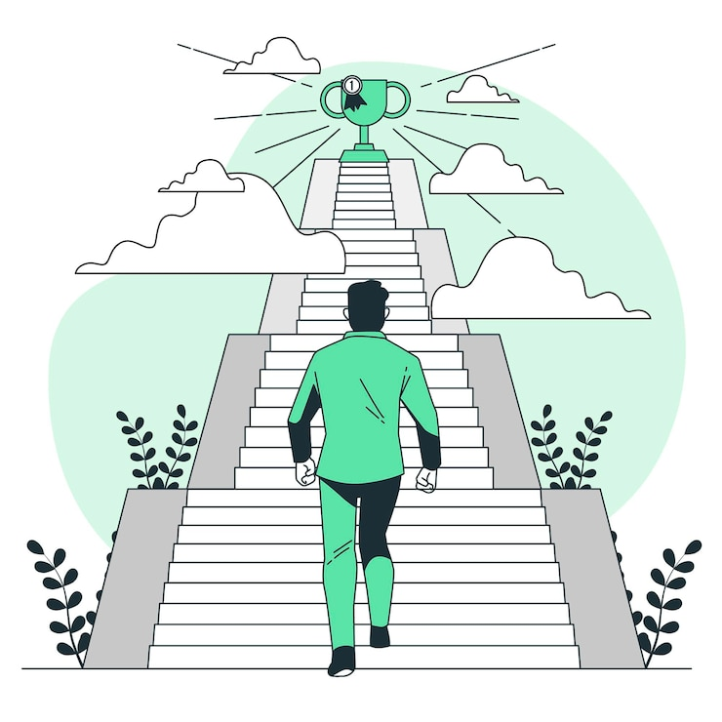
03
MOTIVATION
We are aims to demonstrate the application of artificial intelligence algorithms in solving puzzles.
Provides an opportunity to learn and implement the A* algorithm for solving real-world problems.

Slide 5

04
TECHNOLGY STACK
Flask
Python
A* Algorithm
API
Next JS

Slide 6

05
KEY FEATURES
Play Puzzle Game
Calculates Steps
Provide Solution
API Integrity

Slide 7

06
LET’S LOOK VISUALIZATION
Run Application

Slide 8
DO YOU HAVE ANY QUESTION?
THANK YOU

